Slide 1

ATLIQ BI INSIGHTS 360
12
Executive view
1
Understanding Business Problem
11
Supply Chain View
2
Data Base & Data Warehouse Info
10
Marketing View
3
Data Collection & Understanding
9
Sales View
4
Data Exploration
8
Finance View
5
Data Transformation & Modelling
5
Data Transformation & Modelling
7
Home Page
6
Mock-up Dashboard

Slide 2


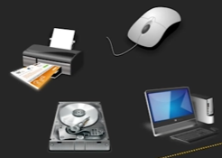








1
Understanding Business Problem
Customers
Consumer
Platforms
Channels
Brick & Mortar
E-commerce
Retailer
Direct
Distributor
1

Slide 3
1
Understanding Business Problem
Customers
Consumer
📊Problem Statement :
AtliQ Hardware is a consumer goods electronics company having operations in various countries. Their business is growing rapidly, and they still rely on Excel files for data analytics.
Excel files are hard to consume and not effective in generating insights. Also due to the lack of effective analytics, the company faced a major loss in Latin America.
Senior executives of this company have decided to invest in a data analytics project and have assigned a team for this work.
As a part of the Data Analytics Team, My goal is to implement an advanced analytics solution using Power BI that will enable the company to get insights and make informed decisions.
1

Slide 4

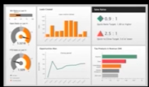
2
Data Base & Data Warehouse Info
Sales Software
Data Warehouse
Extract Transform Load ETL
Customer Relationship Management
Data Analytics
OLTP – Online Transaction Processing
OLAP – Online Analytical Processing
2

Slide 5
3
Data Collection & Understanding
Project Charter
3

Slide 6
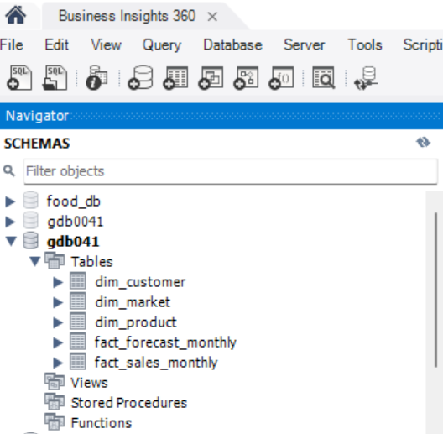
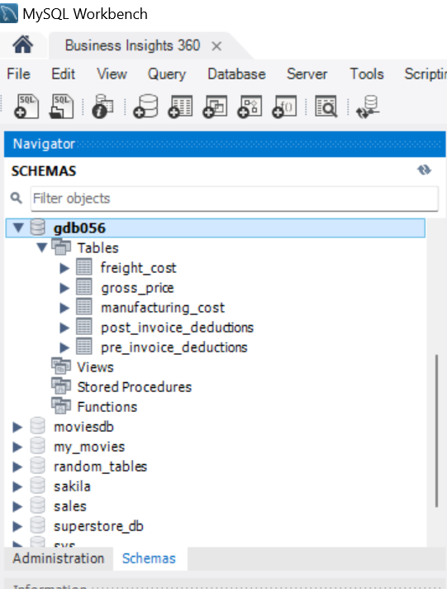
4
Data Exploration
Loading My SQL Databases
DB - gdb041
DB - gdb056
4

Slide 7
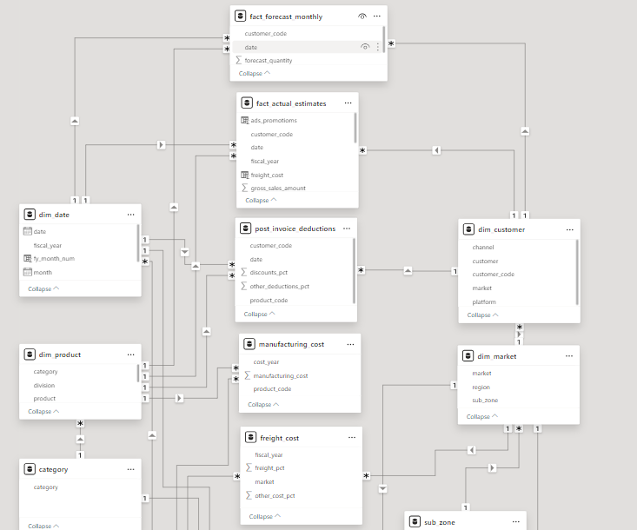
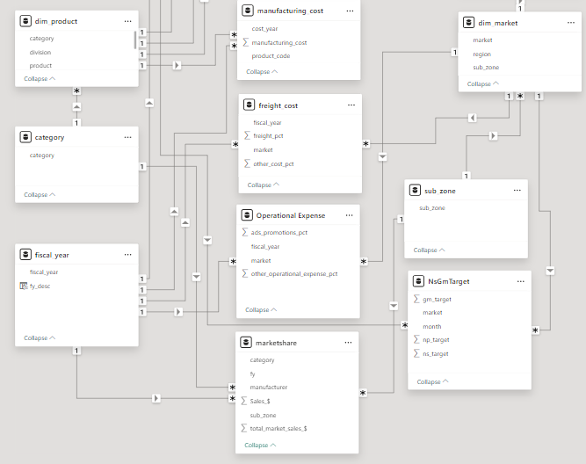
5
Data Transformation & Modelling
Data modeling is fundamental to report creation, forming its structural foundation.
Poor data modeling adversely affects report performance, hindering its effectiveness.
Adherence to best practices in data modeling is essential for optimal report outcomes.
Our project employs the Star schema and Snowflake schema data modeling methods.
These methodologies ensure the construction of visuals on a solid foundation, enhancing the report's efficiency and accuracy.
5

Slide 8
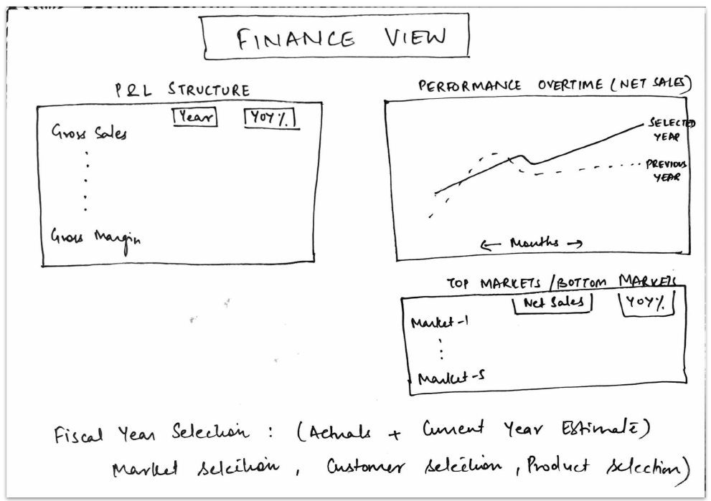
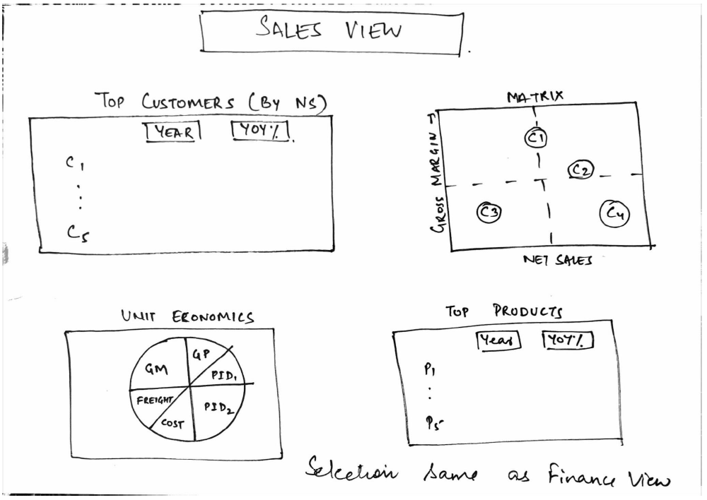
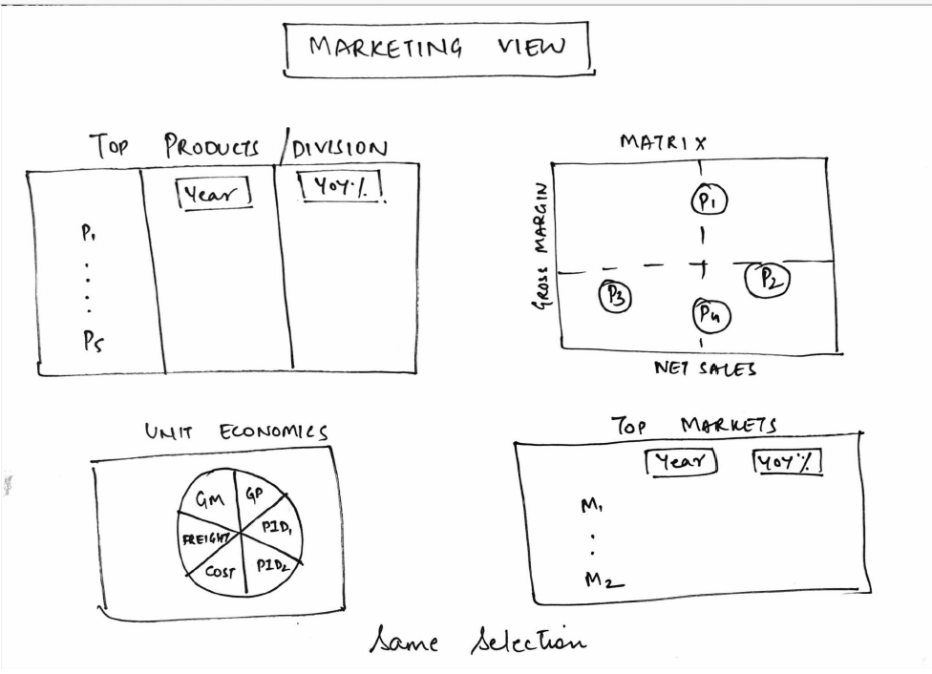
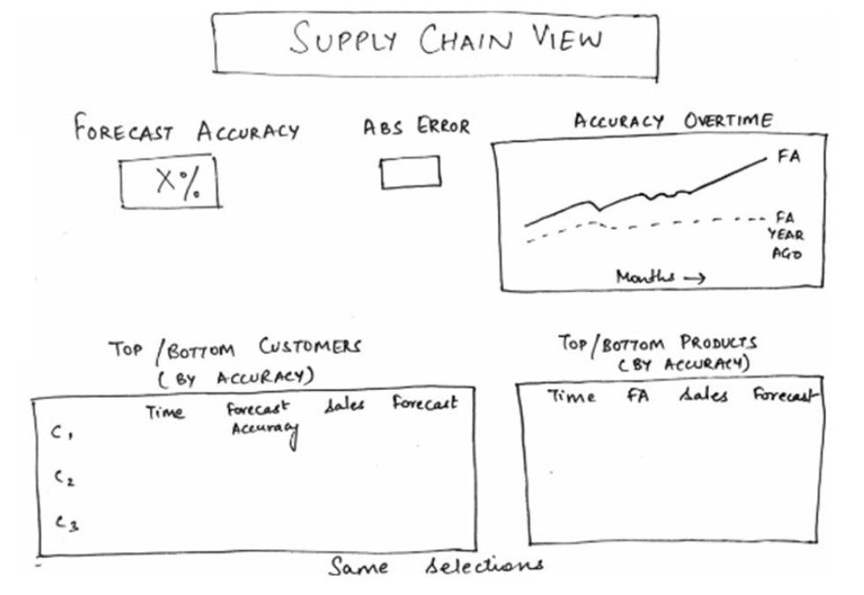
6
Mock-up Dashboard
6

Slide 9
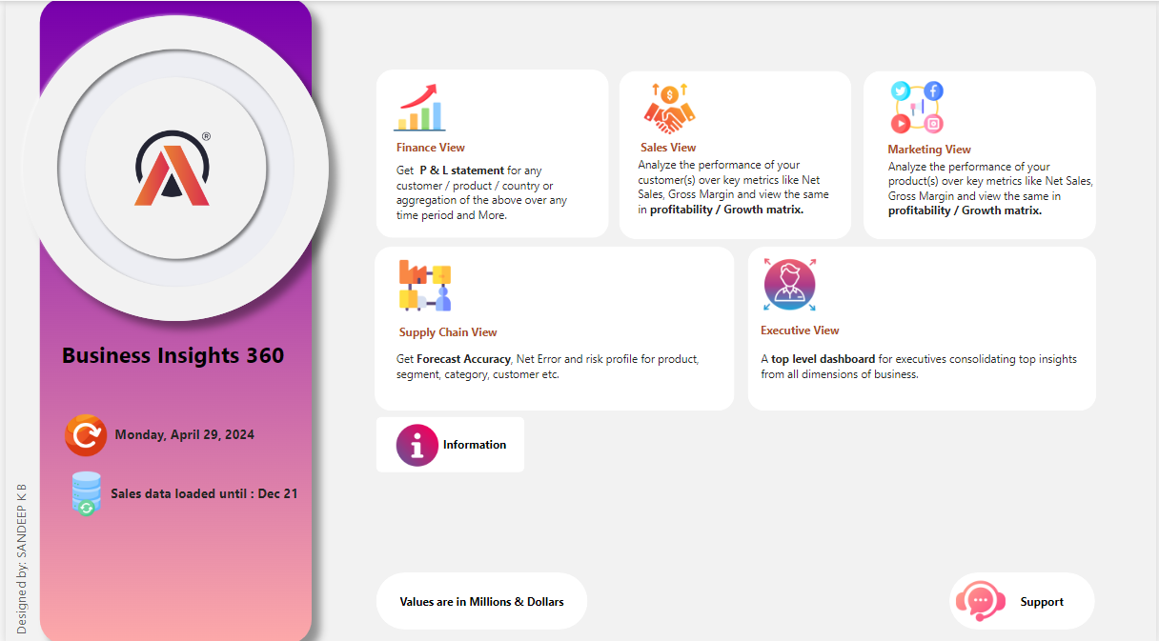
7
Home Page
Home Page
7

Slide 10
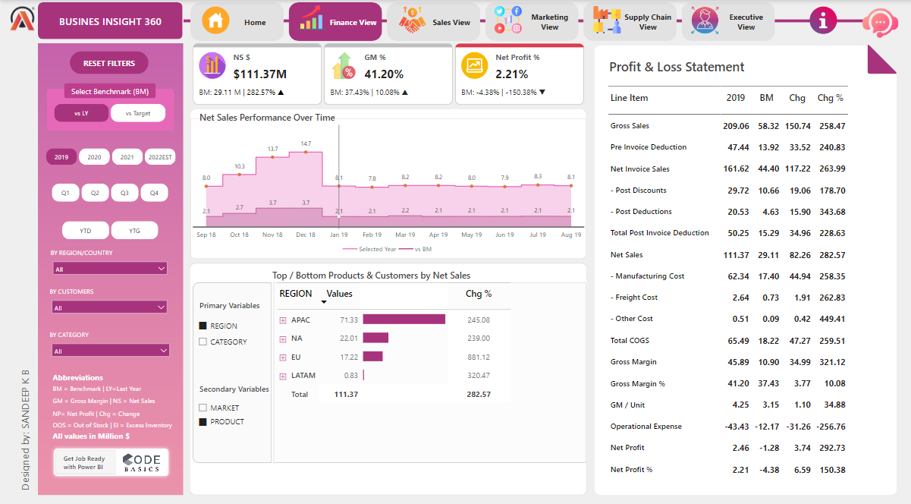
8
Finance View
Finance View
8

Slide 11
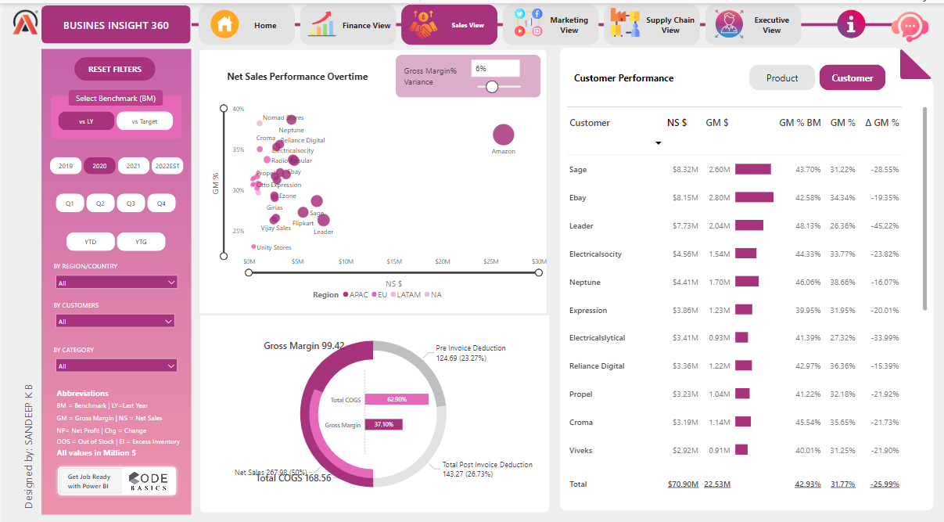
9
Sales View
Sales View
9

Slide 12
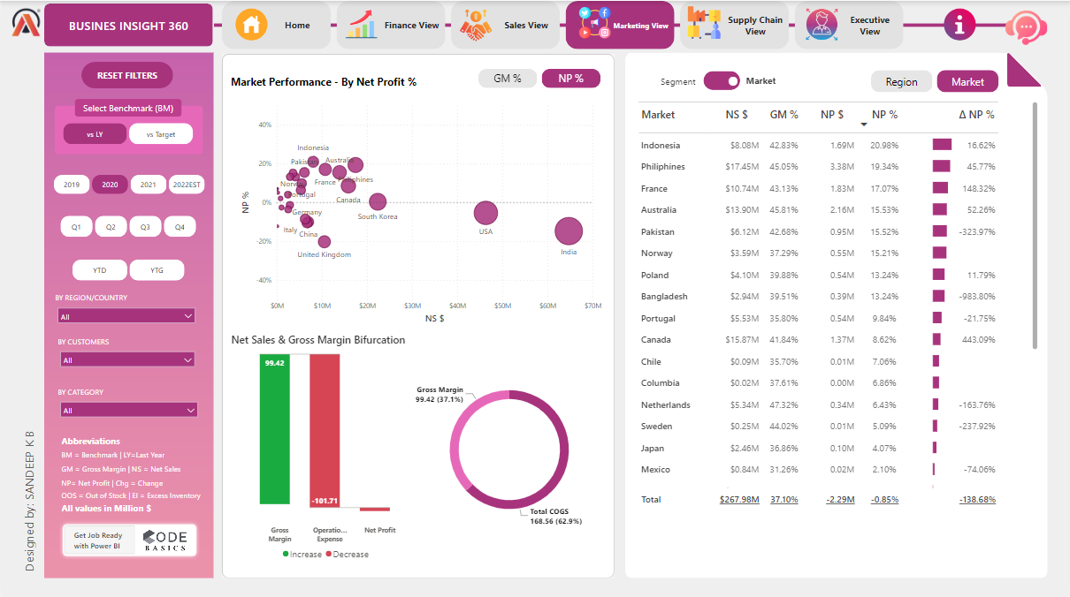
10
Marketing View
Marketing View
10

Slide 13
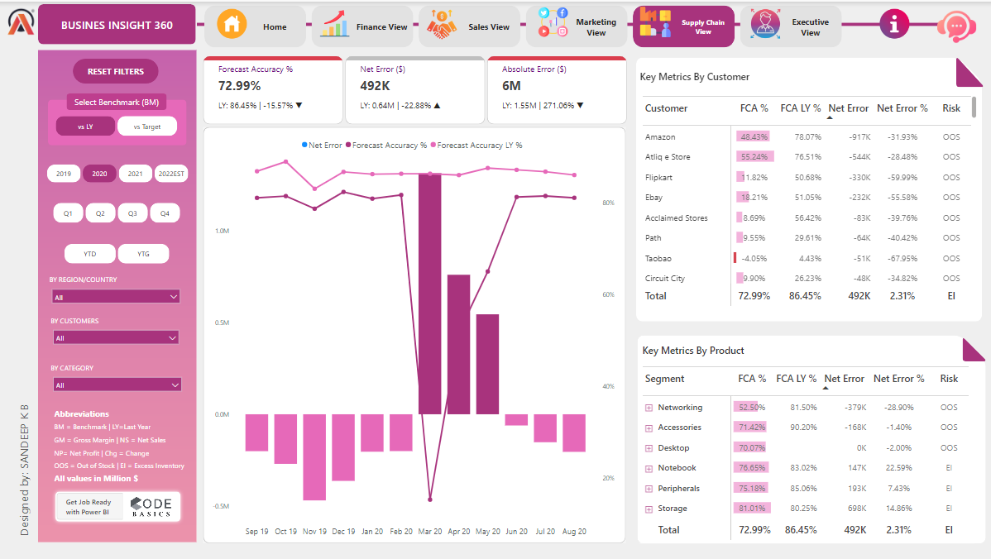
11
Supply Chain View
Supply Chain View
11

Slide 14
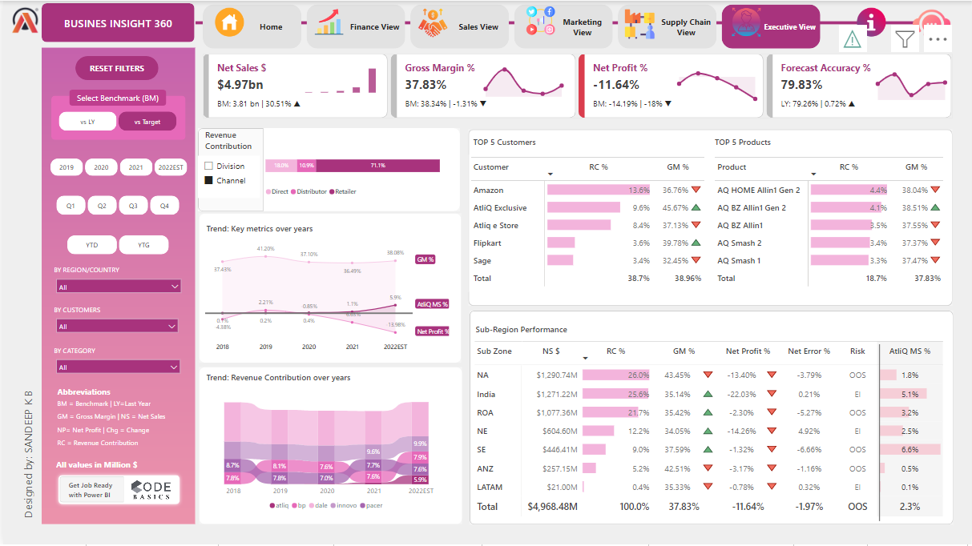
12
Executive view
Executive View
12

Slide 15

THANK YOU
13

